Slide 1
vDSP

Slide 2
Overview
Part of the Accelerate Framework
Provides fast mathematical operations for computationally expensive operations
Vector and matrix operations
FFT
Interpolation
Convolution
Windowing, FIR, and IIR filtering
Operates on real and complex data
C++
Technically, Objective-C++

Slide 3
Passing Data
Input and output vectors (or scalars or matrices) are pass by reference
Vector interleaving is specified by stride length
Complex data is interleaved Re, Im, Re, Im,…
Stride = ???
Note: stride length of 1 has best performance
Need to indicate element count
Non NSObjects, therefore size must be specified
Non-data parameters are pass by value
Example:
// .* two 1,024-point vectors
float a[1024], b[1024], c[1024];
// (in1, in1strd, in2, in2strd, out, outstrd, length)
vDSP_vmul( a, 1, b, 1, c, 1, 1024 );

Slide 4
Passing Data (cont’d)
“Out of place”
The resultant vector (the output) is placed in a separate location from the input(s)
“In place”
The opposite of out-of-place
The input vector is manipulated (and therefore lost!), with the output in its place

Slide 5
Naming conventions
Prefix: All functions begin with vDSP
v – operates on vectors
s – operates on scalars
Suffix:
No suffix indicates single precision (float)
D suffix indicates double float
Additional types:
DSPComplex – an ordered pair of float values stored as a packed data structure
DSPSplitComplex – an ordered pair of float values stored as a pair of pointers into an array of Re and Im parts. Inputs into functions indicated with a ‘z’

Slide 6
Naming conventions
Somewhere in the name:
ip – “in place” processing
op – “out of place” processing
Example: vDSP_fft2d_zipD(…)
Function: 2-dimensional FFT
Return: DSPSplitComplex type (‘z’)
Precision: double float
Does in-place processing

Slide 7
Fourier Transforms
Step 1: create a “weights array” of twiddle factors
What is a twiddle factor?
These only need to be calculated once for an FFT of a given size (can be re-used over and over)
Increases efficiency of FFT algorithm!
Create this array using vDSP_create_fftsetup(…)
Creates the data structure to hold the weights array
Populates the weights array
Returns a pointer to the weights array
Pass to FFT functions

Slide 8
Fourier Transforms (cont’d 1)
Step 2: formatting the input data
A real sequence A = {A[0],…,A[n]} must be transformed into an even-odd array Aeo={A[0],A[2],...,A[n-1],A[1],A[3],...,A[n]}
Easy to do with vDSP_ctoz (remember, ‘z’ indicates the split data format type)
The n-dimension input to FFT → 2n-dimensional output
{[DC,0],C[1],C[2],…,C[n/2],[NY,0],Cc[n/2],…,Cc[2],Cc[1]}
DC and NY: the 0Hz and Nyquizt components
These are accompanined by 0 since they are Re
C is a complex array in split representation
Cc is the complex conjugate of C in split representation

Slide 9
Fourier Transforms (cont’d 2)
Step 3: packing the output data
Some bins have known zeros
DC, and NY are Re magnitudes
pack these together
The conjugate, Cc, is directly computable from C
No need to return Cc
Can pack output to return only 1n elements

Slide 10
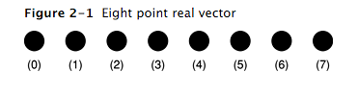
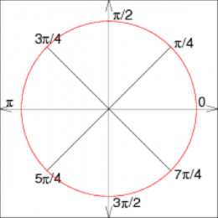
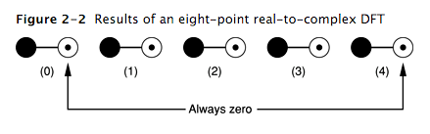

Fourier Transforms (cont’d 3)
Step 3: packing the output data (cont’d)
n elements
FFT
(5) (6) (7)
2n elements
Complex conjugates
Pack
n elements

Slide 11
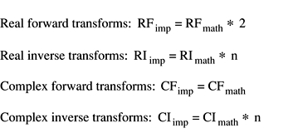
Fourier Transforms (cont’d 4)
Step 4: scaling the output data
To improve efficiency, the FFT (or IFFT) vectors are returned unscaled

Slide 12
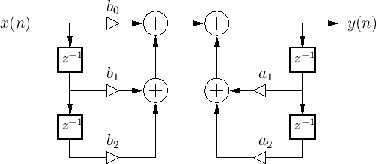
vDSP_biquad
Single-channel, cascaded individual IIR sections
Each section has its own FFW and FBW coefficients
Implemented in direct-form I

Slide 13
vDSP_biquad
CreateSetup(…)
Takes as arguments: the # of sections, and the coefficients array
In multi-channel setups, also pass the # of channels
Note: multi-channel setups are in DF-II
Returns: a setup object
This is passed to the filter execution function
The setup can be called repeatedly
If saved as a @property, make it atomic
Setup can be altered by functions it is passed to, so let’s limit to a single accessor at a time
Will have space for 5 coefficients (3 FFW and 2 FBW) per section

Slide 14
vDSP_biquad
Constructing the coefficients matrix
To implement:
y[n]=b0*x[n]+b1*x[n-1]+b2*x[n-2]-a1*y[n-1]-a2*y[n-2]
Use the following code:
for (vDSP_Length i = 0; i < sections; i++) {
coefficients[i*5 + 0] = (float)b0_for_section_i;
coefficients[i*5 + 1] = (float)b1_for_section_i;
coefficients[i*5 + 2] = (float)b2_for_section_i;
coefficients[i*5 + 3] = (float)a1_for_section_i;
coefficients[i*5 + 4] = (float)a2_for_section_i;
}

Slide 15
vDSP_biquad
The filter execution function takes in:
The setup object with filter coefficients
Pointers to the input and output arrays
The stride
A pointer to an array of delay values (state memory)
An array of floats of past delay values for each section
Length is 2*M+2, where M is the # of sections
This array is updated with new values by the filter
The number of samples to be processed

Slide 16
vDSP_biquad
Code Example:
// Delays array for 1 section
float delays[4] = {0.f, 0.f, 0.f, 0.f};
// coefficient array of length = 5x #of cascaded sections
double filterCoeffs[5] = {mB0, mB1, mB2, mA1, mA2};
// setup object
vDSP_biquad_Setup setup =vDSP_biquad_CreateSetup(filterCoeffs, 1);
// filter
vDSP_biquad(setup, delays, in, 1, out, 1, numFrames);
vDSP_biquad_DestroySetup(setup); // Destroy

